Slide 1

Design of the Theme Park
Bicycle Rental System
SWS3002 Group01
Song Ziye, Huang Yuyang, Ji Xiangtian, Tu Teng

Slide 2
01
Introduction
02
Data Analysis & System Design
Content
03
Experimentation
04
Results & Analysis
05
Conclusion

Slide 3
https://www.ypppt.com/
01
Introduction

Slide 4
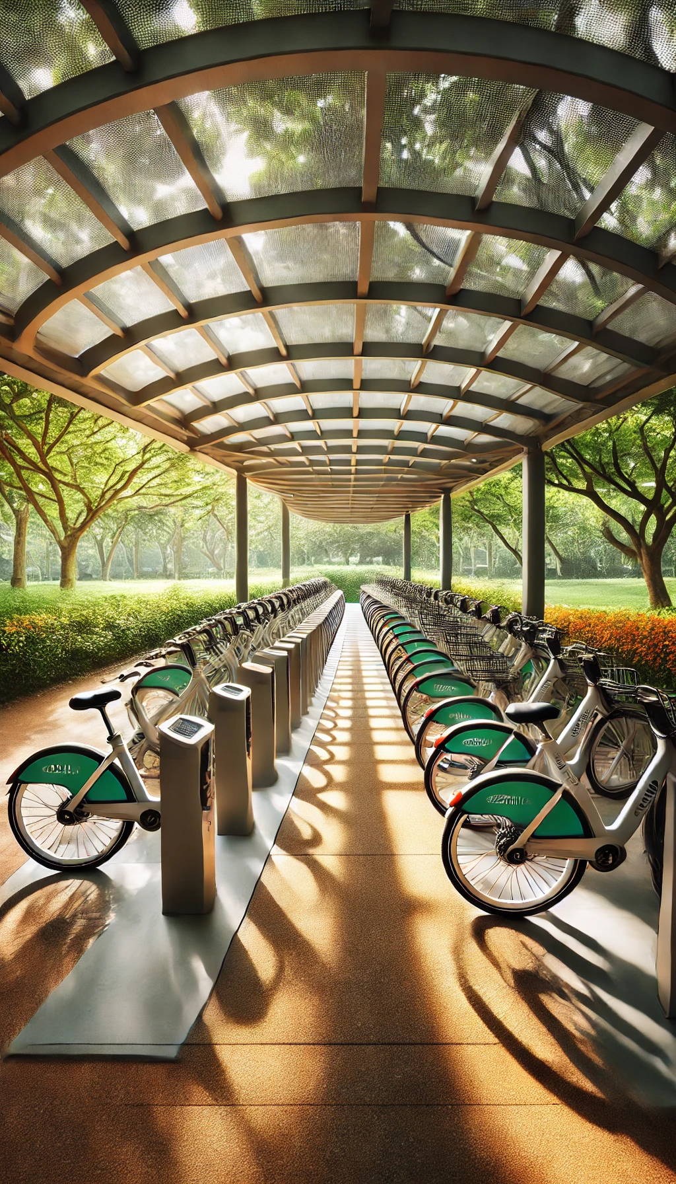

Background Introduction
Popularity Background
Issues
Tasks

Slide 5


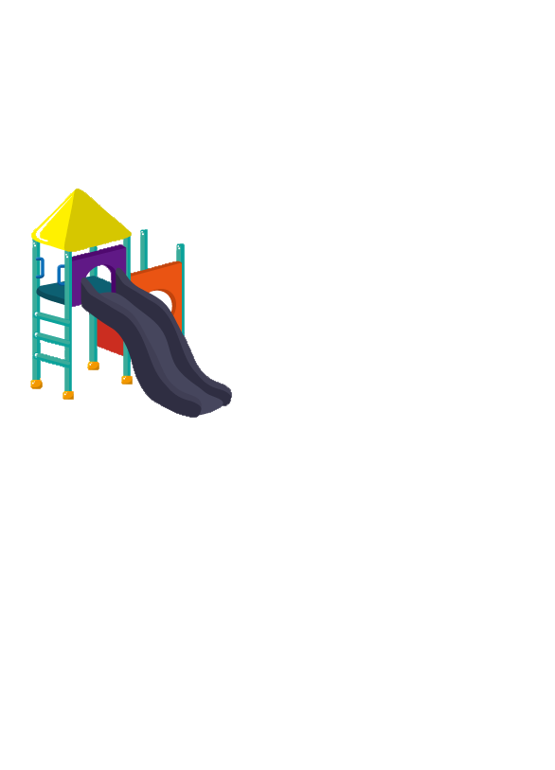




Introduction to Problem Description
Attracitons and Stations
One-Way Roads
Visitor Riding Rules
Att. A
2km
Att. B
1km
Att. D
Att. C
2.5km
3km

Slide 6
Introduction to Problem Description
Bicycle shortage
Wait Time Increase
01
Difficulty in Getting Bicycles
Dock shortage
Wait Time Increase
02
Difficulty in Returning Bicycles

Slide 7

Introduction to Basic Assumptions
Terminating Simulations
1
Assuming the theme park is open 24 hours a day and 7 days a week(10080 minutes), the last few hours of each week are dedicated to cleaning and restoration. Specifically, the park closes at 9500 minutes, during which no new visitors are allowed to enter. Visitors already inside can continue their activities. At 9900 minutes, staff will restore all bicycles to their initial state, and all visitors will leave the queue.
Assumption 1
Visitor Transition Rates
2
Assumption 2
75% of visitors who visit two scenic attractions will proceed to visit a third attraction.
50% of visitors who visit three scenic attractions will proceed to visit a fourth attraction.
3
Assumption 3
Bicycle Sale & Dock Exchange
Assuming the bicycle can be sold for $50, which means 2 bicycles can be exchanged for 1 dock.
Queue Simulation & Instant Service
4
Assumption 4
The bicycle pick-up and return in different stations are each simulated with a single queue, ensuring there are no multiple queues. The time for returning and picking up bicycles is completed instantaneously.

Slide 8
Data Analysis & System Design
02

Slide 9
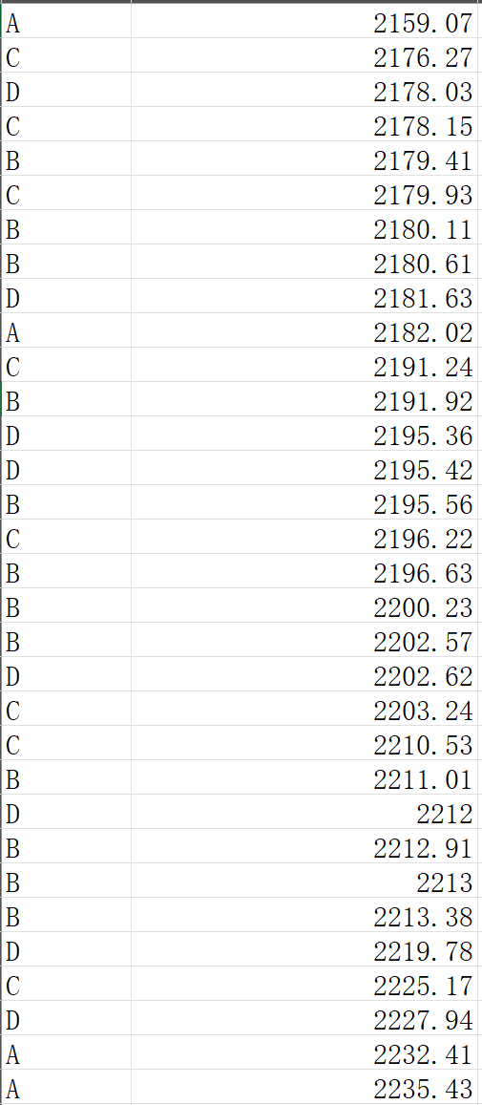
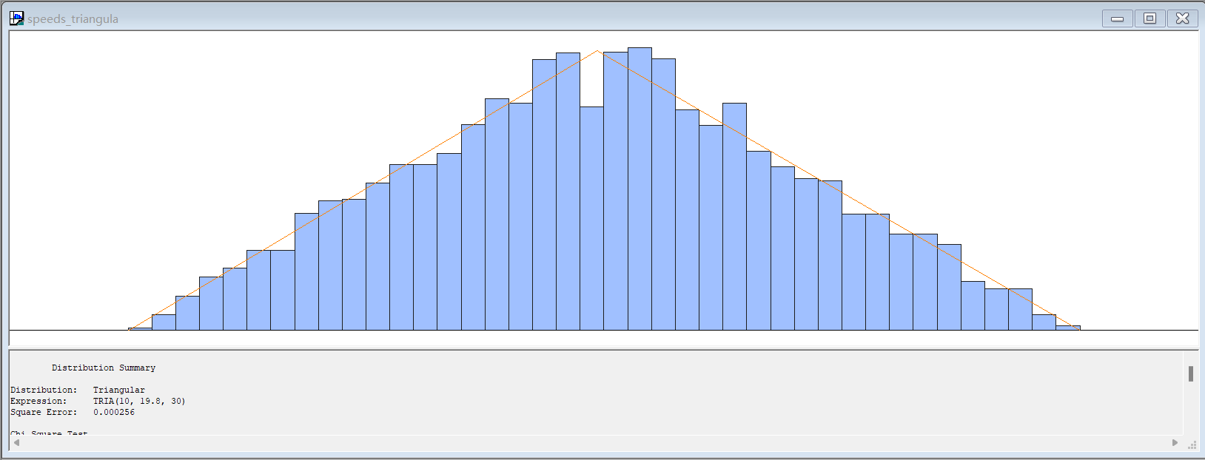
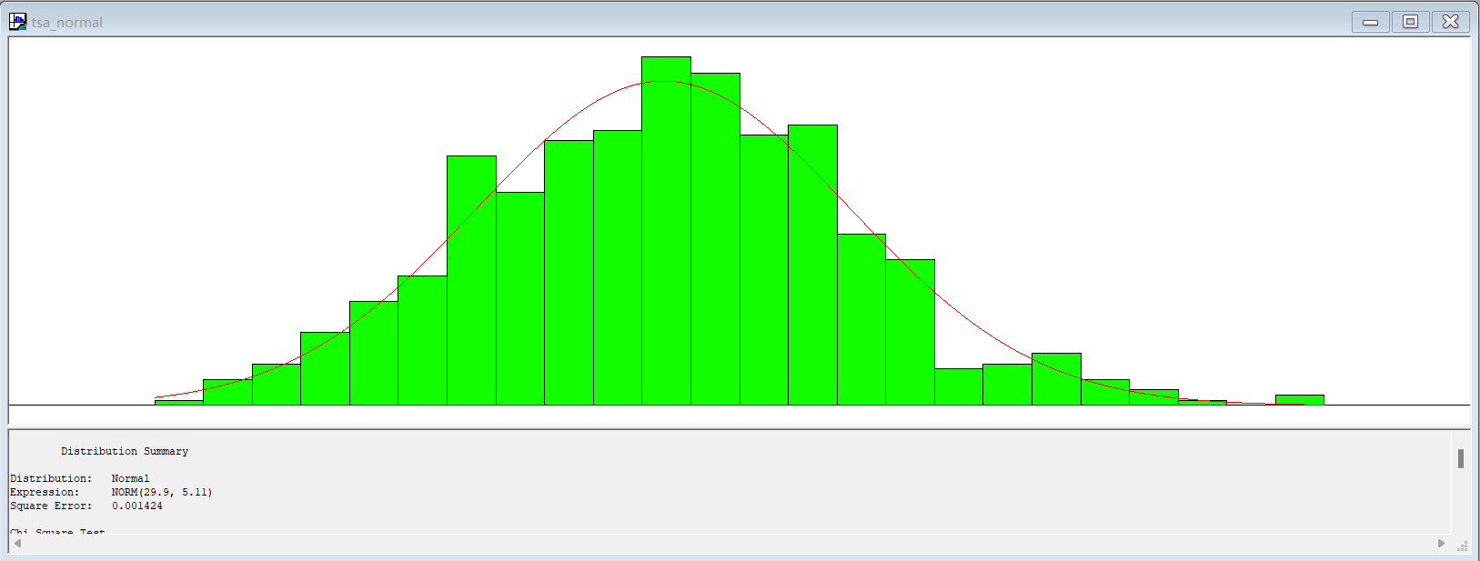
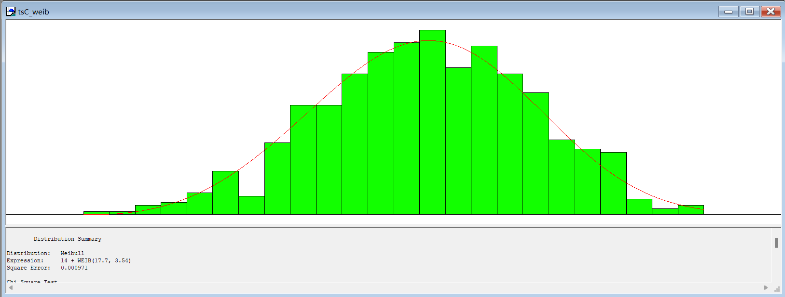
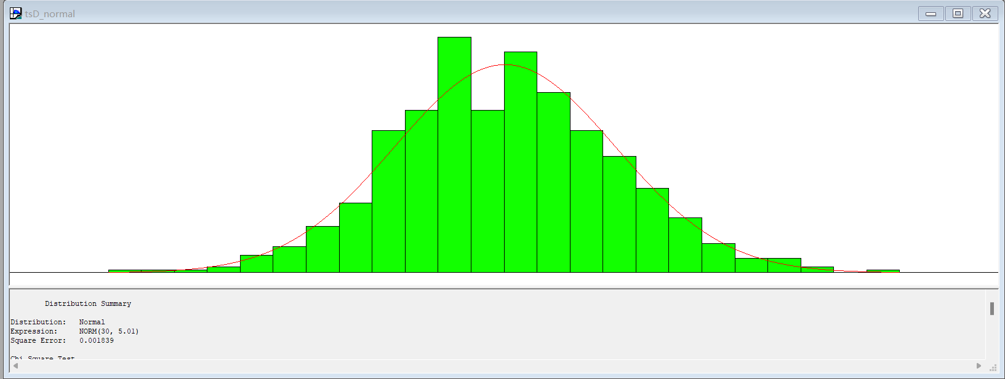
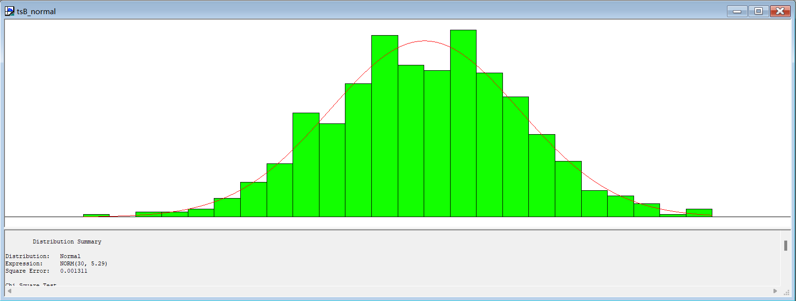
Data Analysis
01
speeds.xlsx
02
arrivals.xlsx
We will discuss this file later.
03
timespent.xlsx

Slide 10
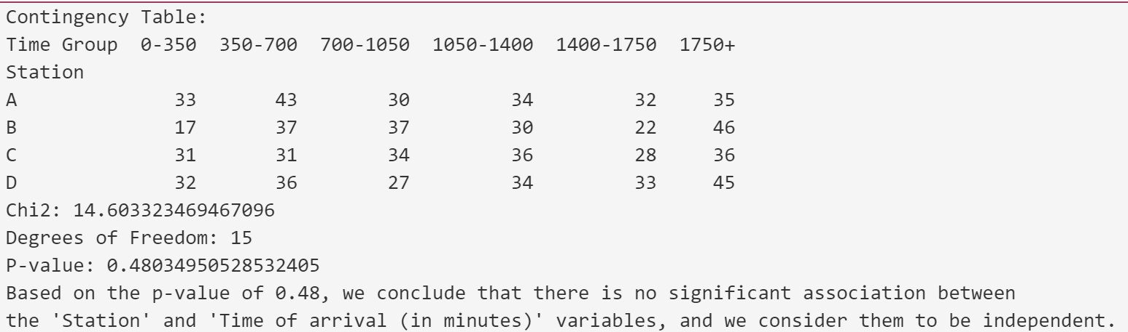
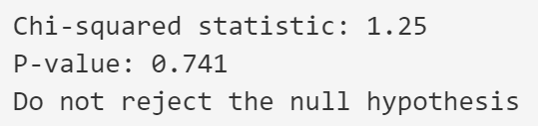
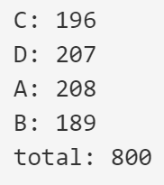
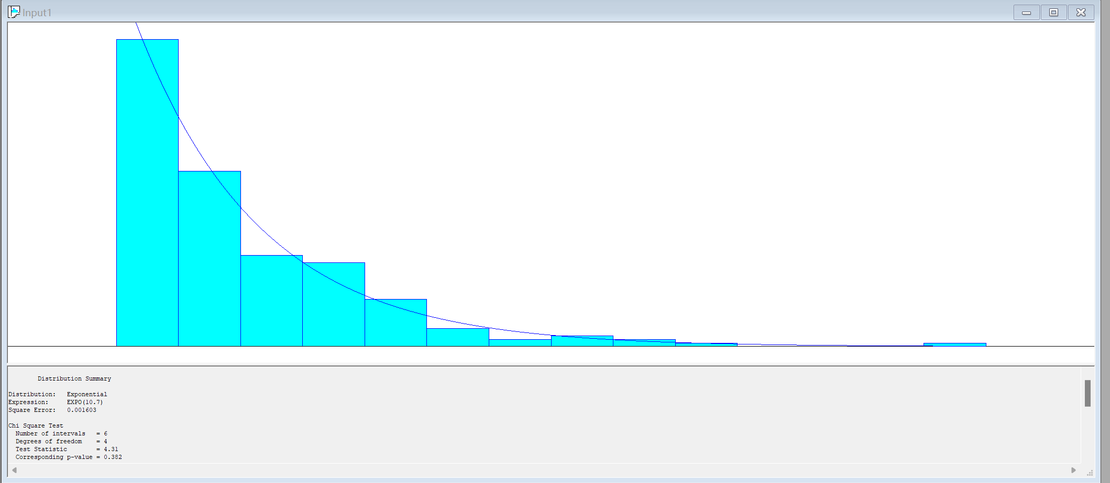
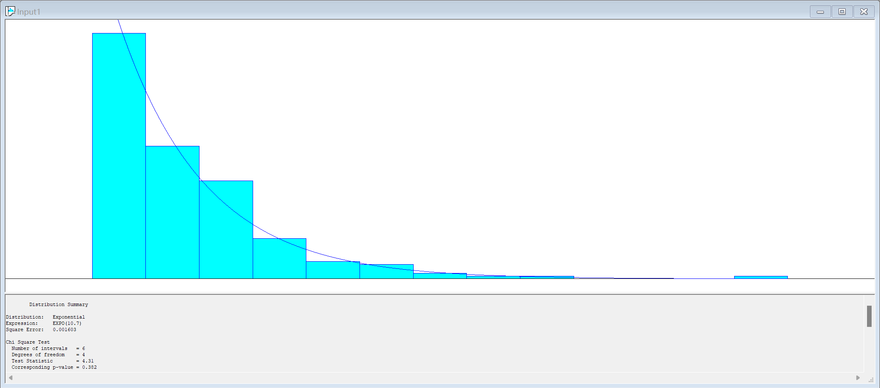
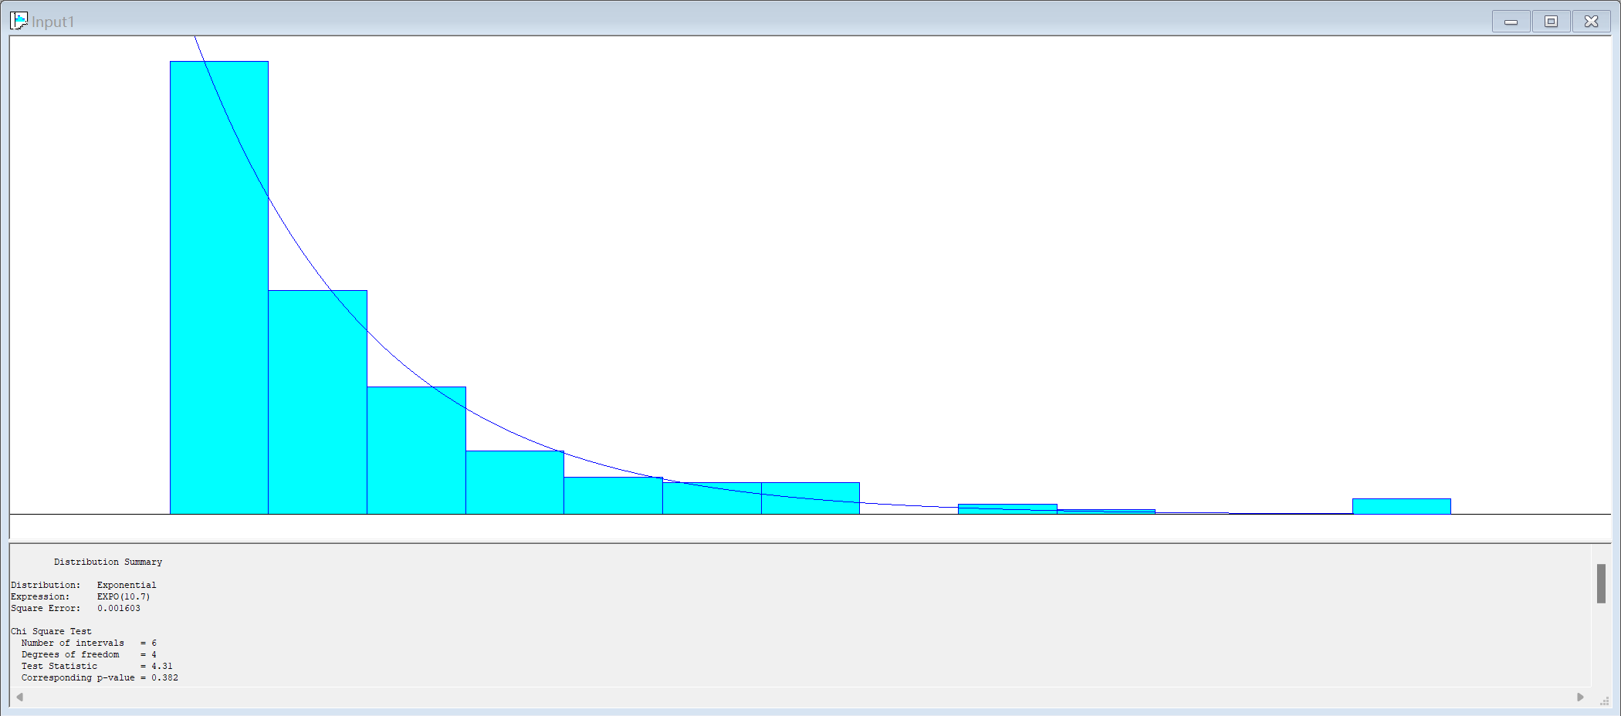
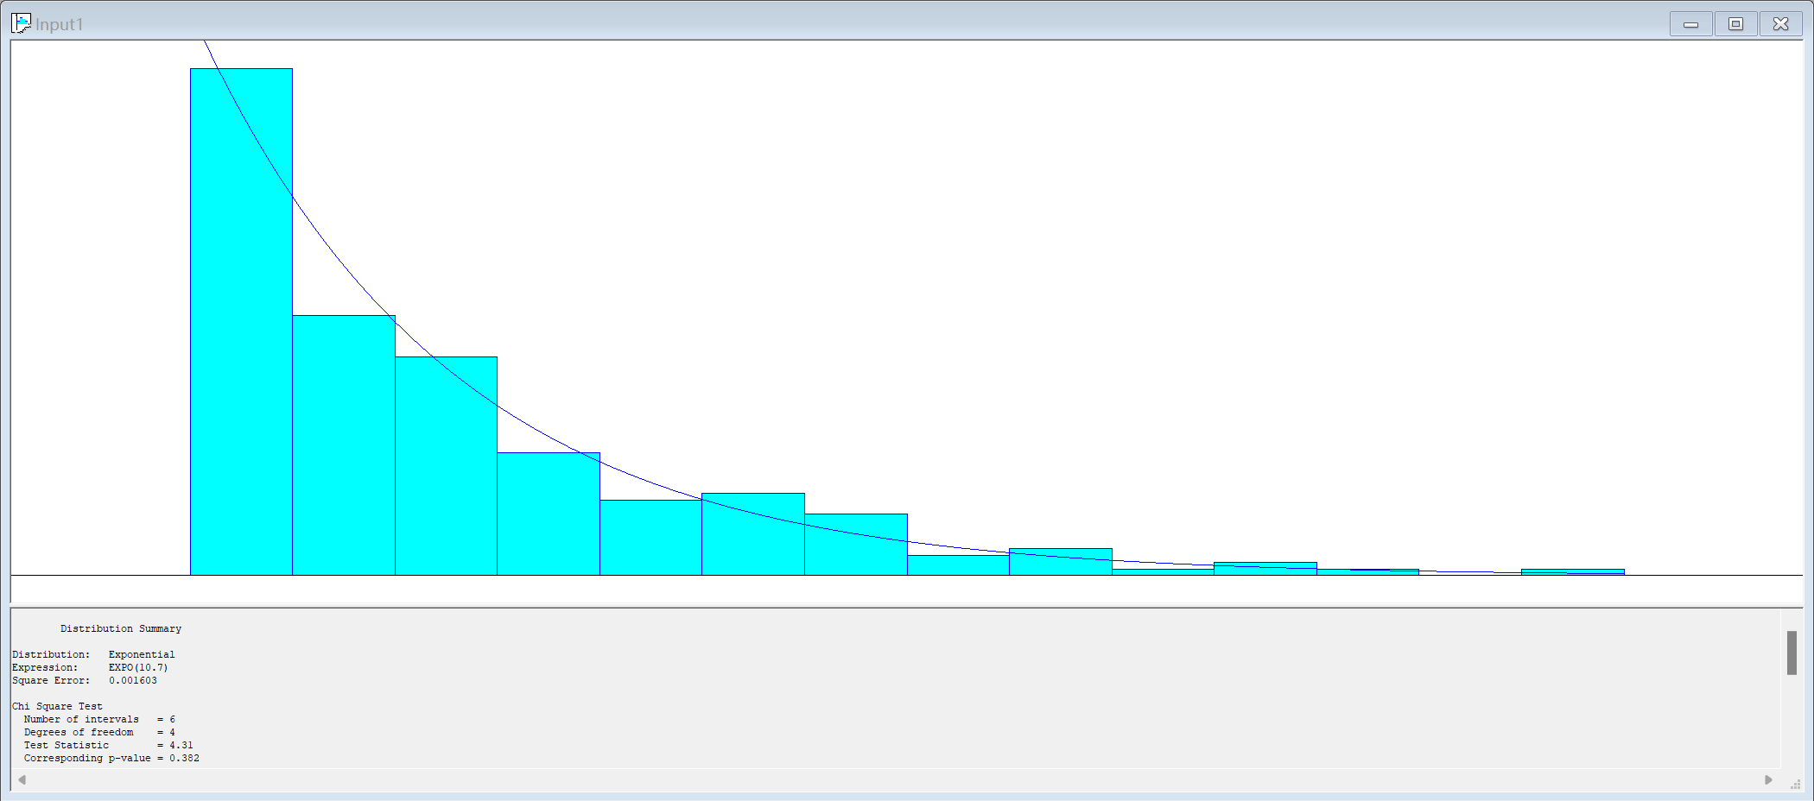
Analysis in arrival.xlsx
Pearson's Chi-Square Test for Independence
01
02
Pearson's Chi-Square Test for arrival distribution independence
03
Fit arrival distribution
In different attractions

Slide 11
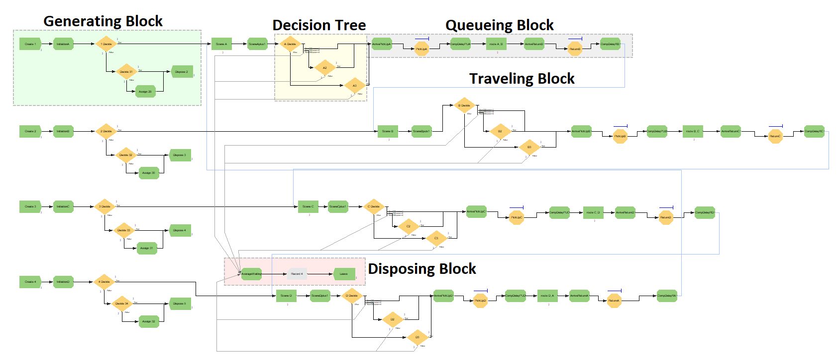
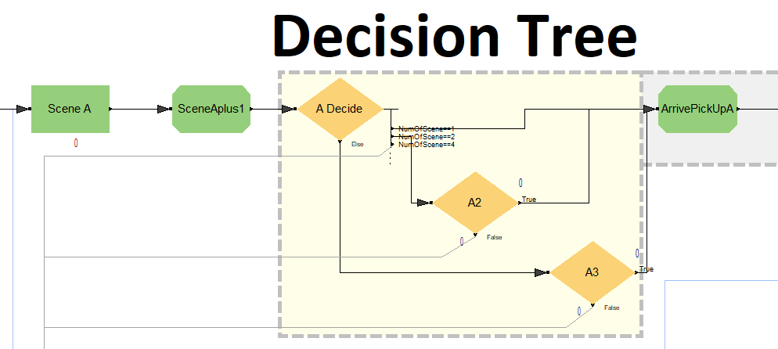
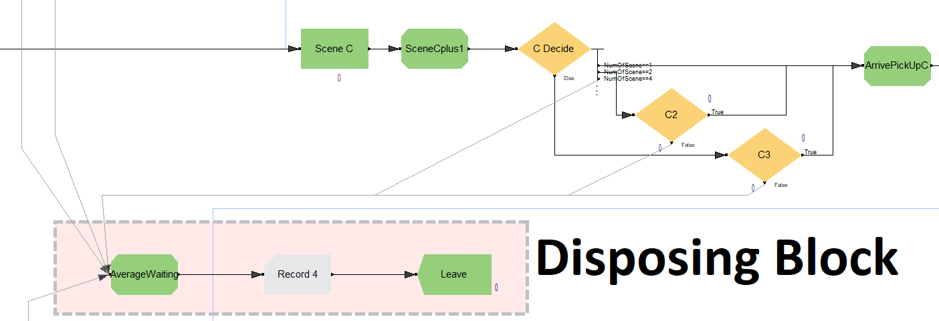
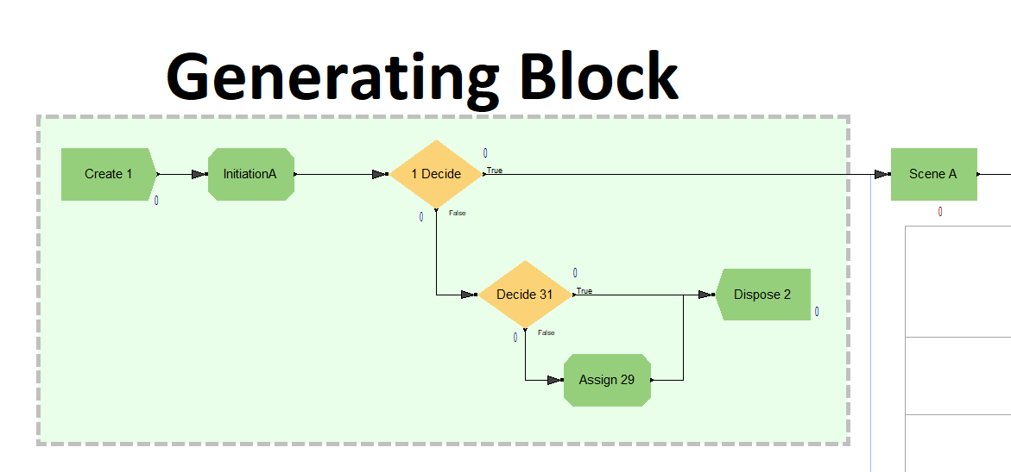
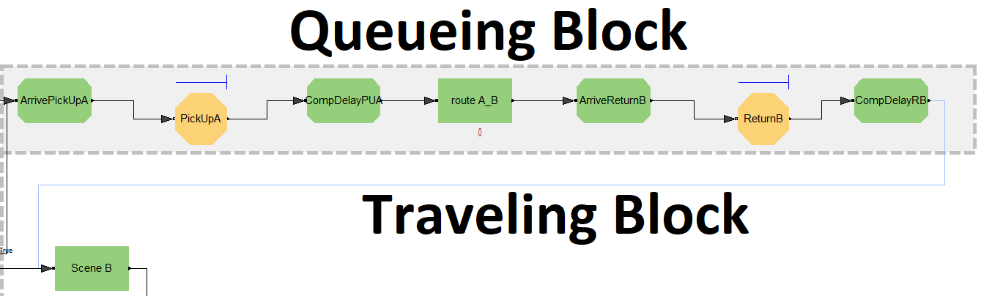
System design
Disposing Block
Decision Tree
04
02
01
03
Generating Block
Queueing Block & Traveling Block

Slide 12
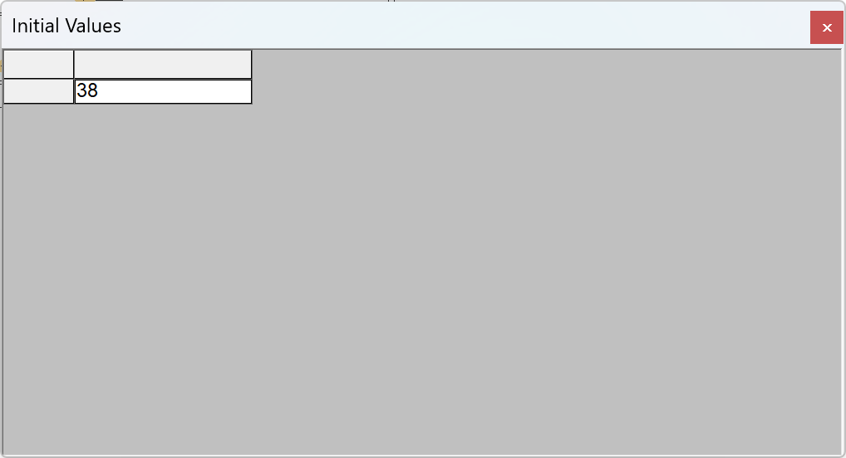
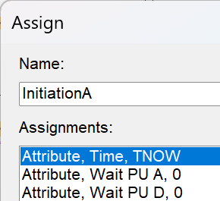
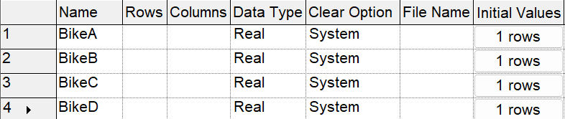
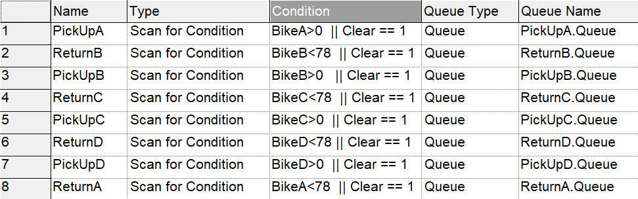
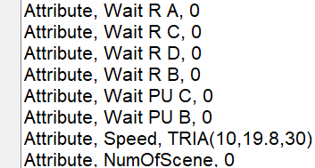
System design
01
02
03
Initiation
Bicycle
Dock
Assign Module
Variable Module
Hold Module
Set Initial Values
Set Condition
PPT下载 http://www.1ppt.com/xiazai/

Slide 13
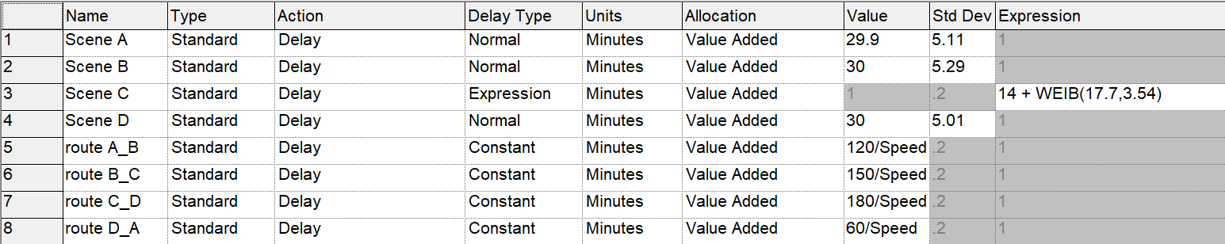
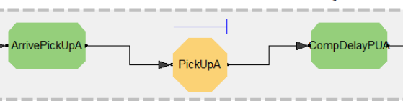
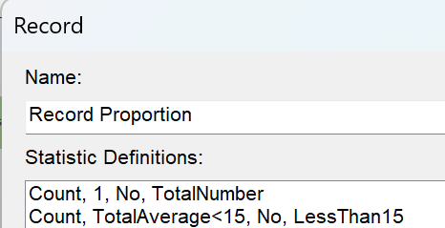
System Design
Simulating Delay
Computing Hold
Record

Slide 14
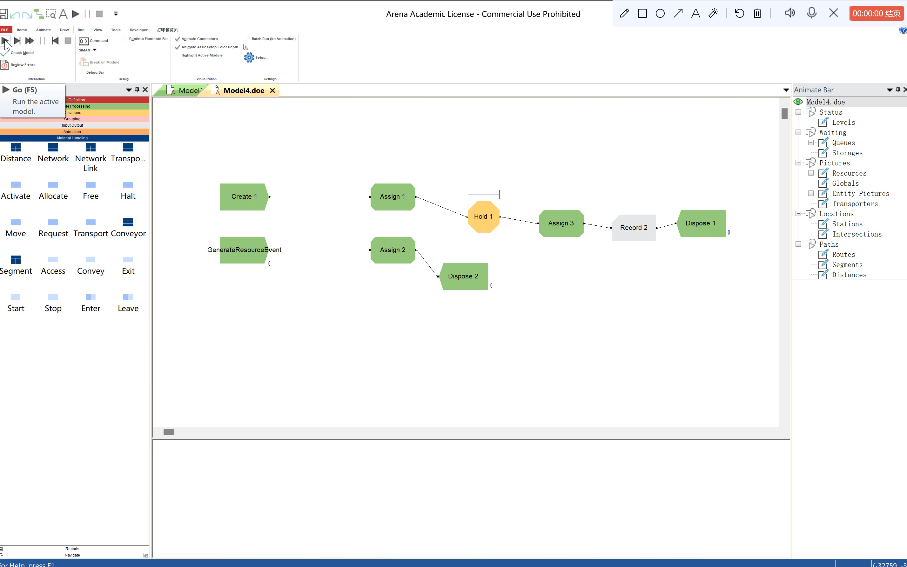
Verification & Validation
Verification with Tracing the Simulation
Verification with
Other strategies
Verification with Commonsense methods
Verification with Structured programming

Slide 15
Verification & Validation
Calibration
01
02
Face validity
Model assumptions – structural and data
03
04
Input-output transformation

Slide 16
03
Experimentation

Slide 17
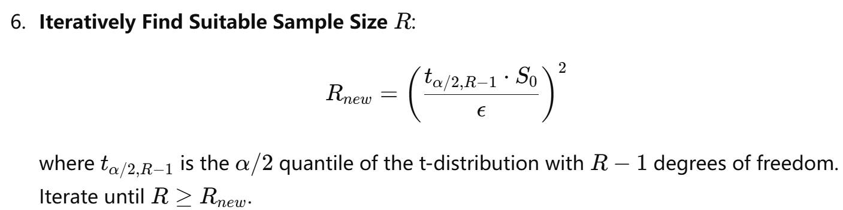
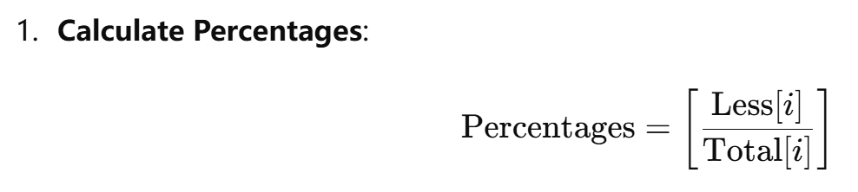
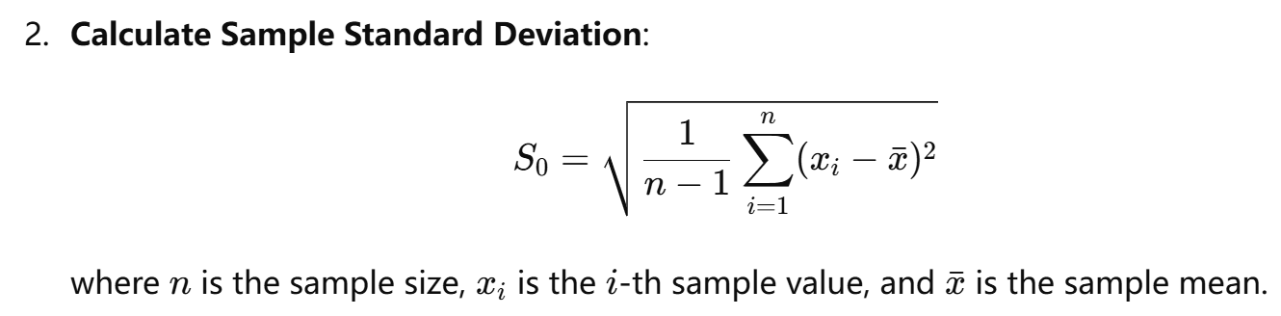
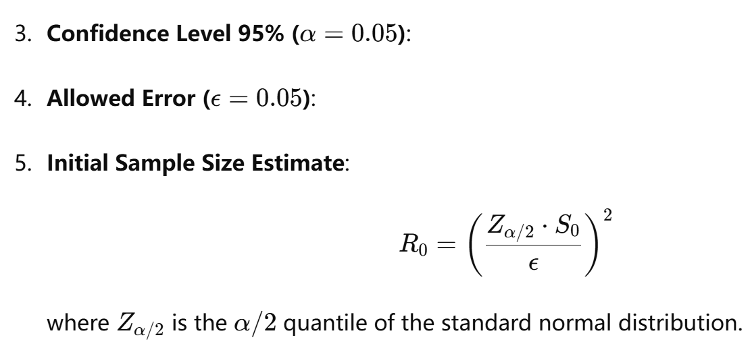
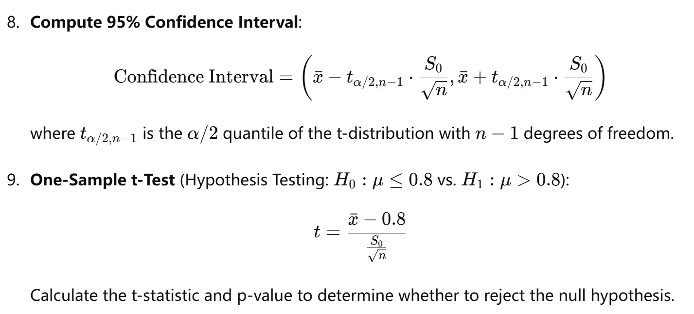
Experimentation

Slide 18
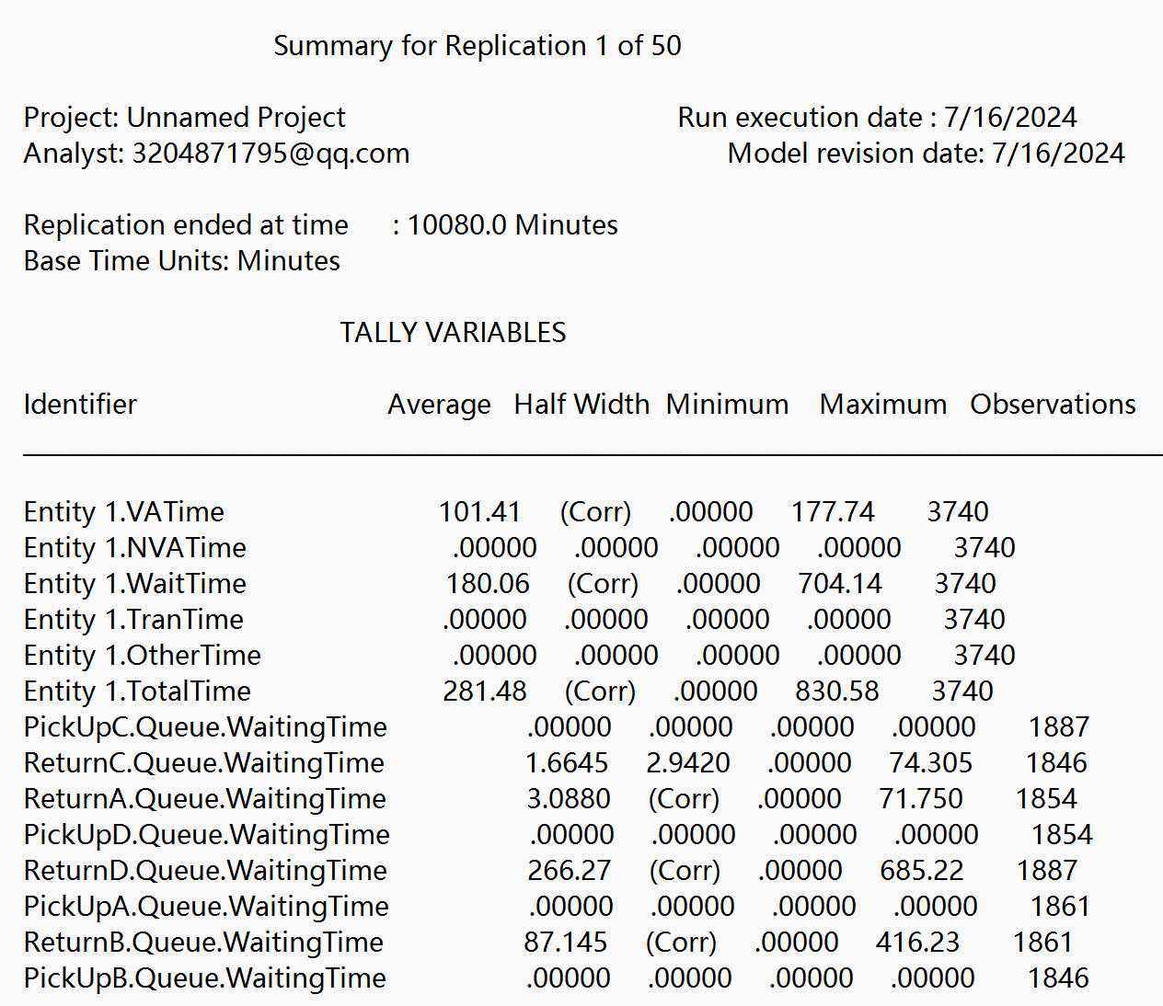
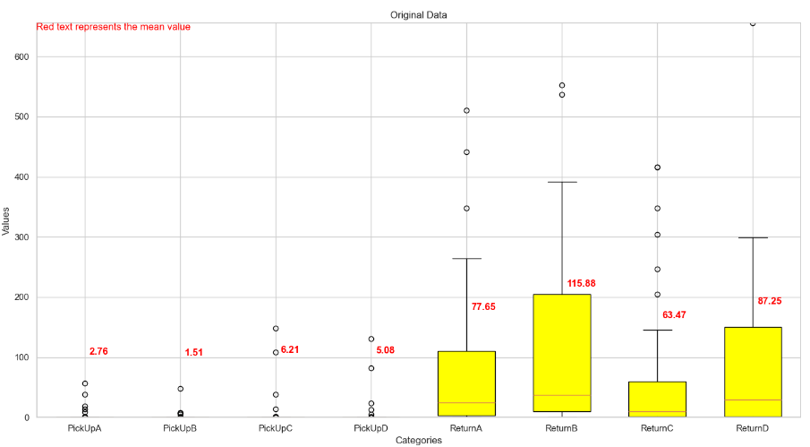
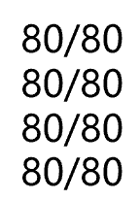
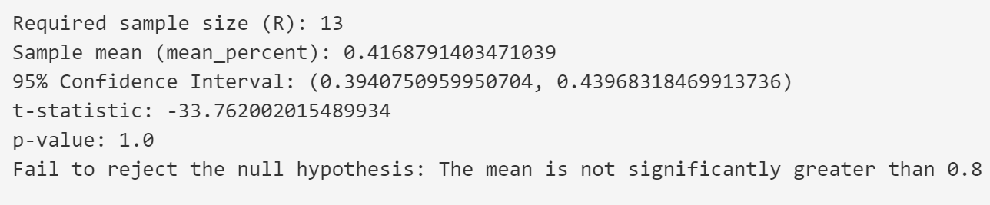
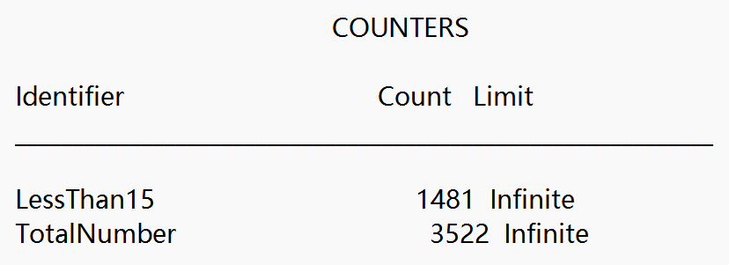
Experimentation
02
Run Original State
Make Conclusion
Analyze Output
01
03
50 replications

Slide 19
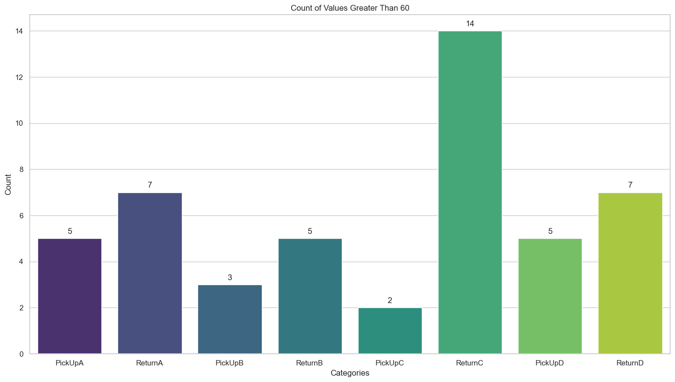
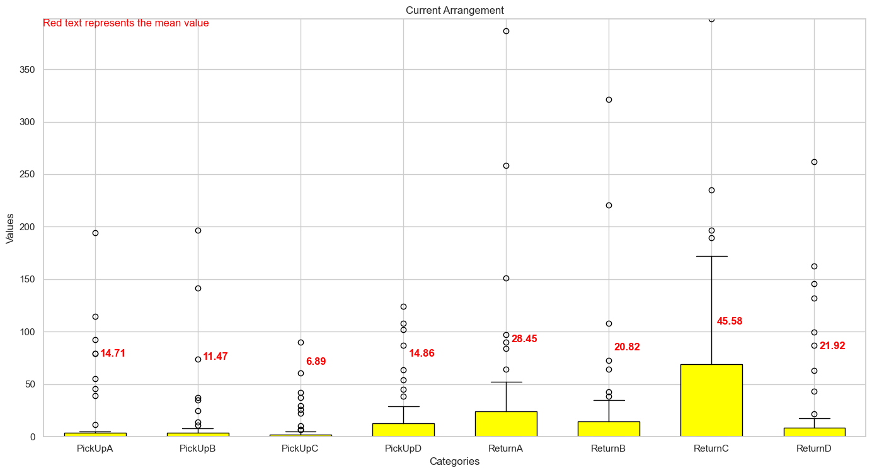
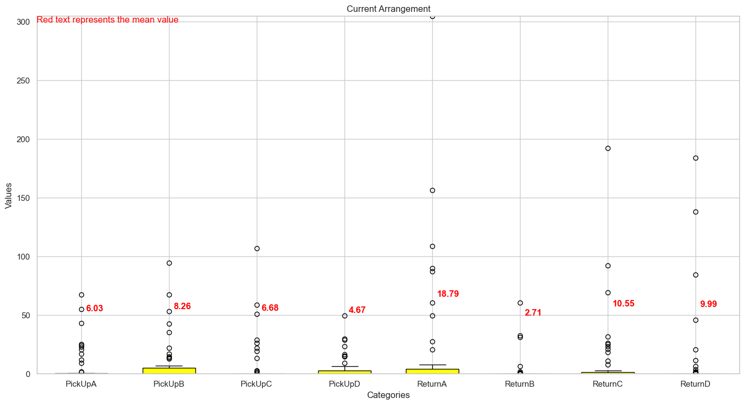
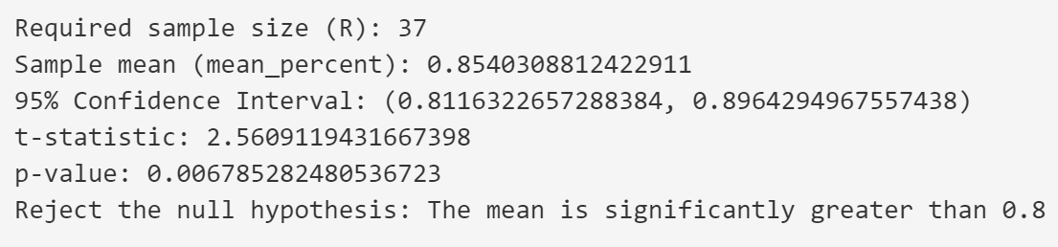
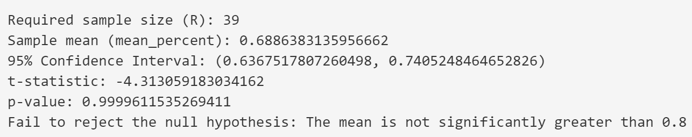
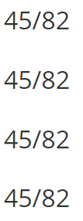
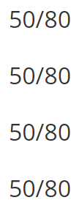
Tune parameters
Find the best arrangement
Tune the number with output
Add the number of docks
Reduce the number of bicycles

Slide 20
04
Results & Analysis

Slide 21
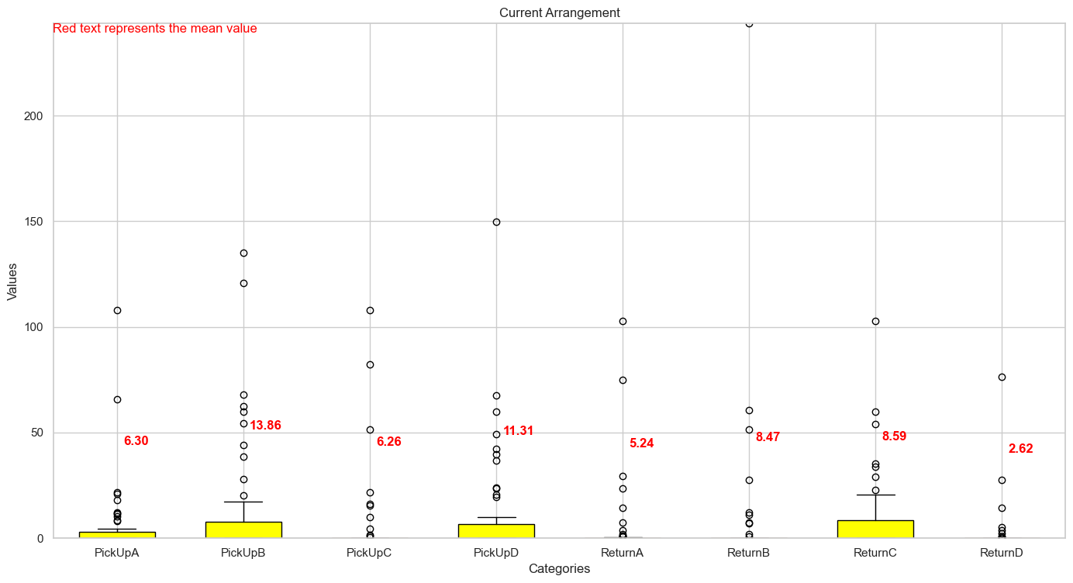
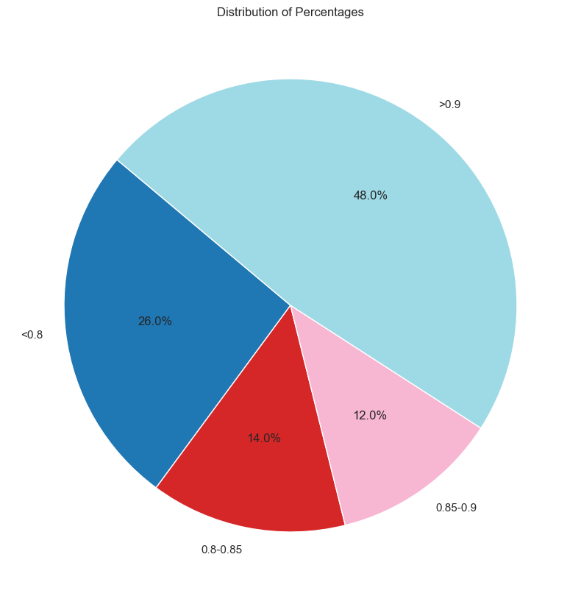
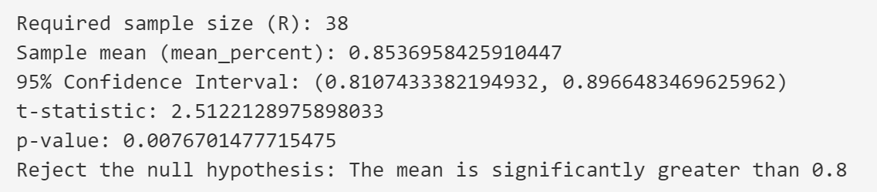
Results & Analysis
45/82
45/82
45/82
45/82
38/78
40/78
43/78
36/77
Profits:
$6200
$8150

Slide 22
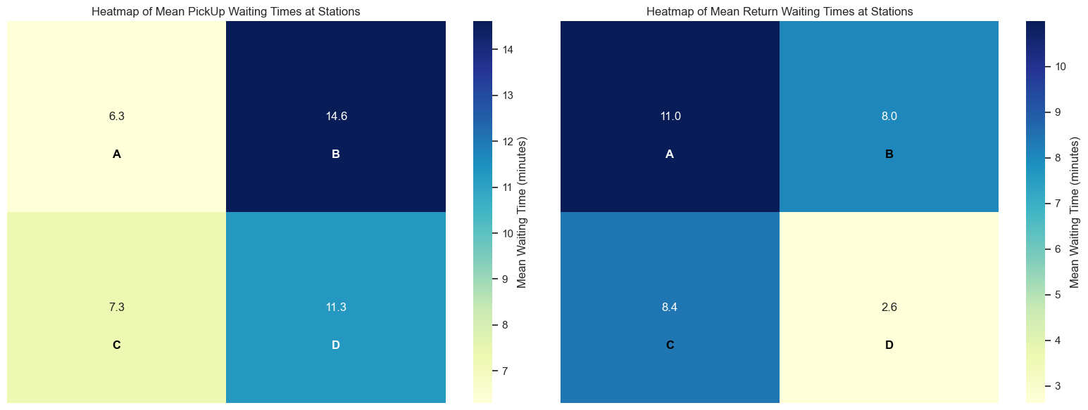
38/78
40/78
43/78
36/77
What if we reduce 1 bicycle in A station or reduce one dock in D station?

Slide 23





Results & Analysis
A small change can trigger a transformation in the entire system.

Slide 24
05
Conclusion

Slide 25





Conclusion
Additionally, we also have done further experiments to find the most profitable solution, under the circumstance that numbers of bicycles and docks are not the same for each attraction:
The average waiting time for renting or returning bicycles exceeded one hour in total for a significant portion of tourists. This indicates that the current system is not satisfactory according to the management's criteria.
02
04
01
Assuming the bike is sold at $50, we could earn $8150.
We successfully created a model of the bicycle rental system using Arena and conducted thorough simulations with satisfactory verified and validated.
03
To have the average waiting time of over 80% tourists less than 15 minutes, we need:
Assuming the bike is sold at $50, we could earn $6200.

Slide 26

Further research
01
Improvement on arrival data
The interval of the guests’ arrivals of a theme park is distributed following exponential distribution throughout the time ( over 2k minutes, over 1 day), researching with a distribution that is not affected by time seems unreasonable.
We suggest to re-modeling it with a different arrival data to not only make a better model but also research how the bicycle-dock arrangement changes when the arrival data differs.

Slide 27


Further research
02
Low stability of the model
In result & analysis, when we give away 1 bike, the average waiting time tremendously increased.
this shows the low stability of our model, and we wonder if this is acceptable and how to improve it.

Slide 28
Further research
M_{A} = N_{A} = M_{B} = N_{B} = … = 80
M_{A} ≠ N_{A} , M_{A} ≠ M_{B} , …
03
Higher/different requirement
Att. A
We have given the most economical solution to have over 80% tourists waiting for less than 15 minutes on average.
For a better result like 90% tourists waiting for less than 5 minutes or a different requirement like having more attraction and roads, further research needs to be done.
Besides, we also need to study when the requirement differs, how does the cost increase.
N_{A}
1
Att. B
M_{A} bikes
N_{A} docks
…
2
M_{B}, N_{B}
2
3
Dock
1
…
One-way bikeway
…
…
M_{C}, N_{C}
M_{D}, N_{D}
…
Att. D
Att. C
…

Slide 29

Thanks for your watching
Song Ziye, Huang Yuyang, Ji Xiangtian, Tu Teng

